Slide 1


Hospital Solutions

Slide 2

ABOUT US
SkyBits Technologies, Is an Artificial Intelligence software development firm providing solutions and products to various global clients. It was founded by the veterans of the IT industry with immense global experience. The core focus areas for SkyBits are Image Processing and Natural Language Processing (NLP) based on strong foundations in Deep Learning technologies.

Slide 3
Management Team and Founders
Debabrata Dutta, Founder and Executive Director
Industry Experience: 30 Years
Past Organizations: DRDO, Wipro, Lucent, Ushacomm
Expertise: Machine Learning, Telecom, Parallel Computing,, Mobility
Education: M Tech Computer Sc. IISc Bangalore; B Tech Computer Sc. IIT Kharagpur
Satyajit Roy - Head of International Business Development
Industry Experience: 4 Years
Past Organizations: DNV, Go Marine, Early Stage Start-ups
Expertise: Technology Evaluation, Data analytics, management systems, Business Development, Six Sigma Black Belt
Education: Electrical Engineering and Economics from Pennsylvania State University
Ambar Mukerji, Executive Director
Industry Experience: 32 Years
Past Organizations: Lovelock/Flakt/Digital (DEC), Xerox, Telstra, UshaComm and early stage companies as CFO/COO/CEO.
Expertise: Financial and Business Management and Business Development and Financing
Education: Chartered Accountant

Slide 4
Tirthankar Banerjee – Advisor
Industry Experience: 30 Years
Past Orgs: Digital, Compaq, Sun, HCL Tech, HP
Expertise: Business Management, Machine Learning
Education: PGDM Marketing IMT; B Tech E&ECE IIT Kharagpur
Capt. Soumitro Roy - Advisor
Sujan Sinha – Advisor
Industry Experience: 40 Years
Past Orgs: Mobil, SCI, Reliance Industries, KOTC, ADNOC
Expertise: Commercial and operational Management of ships, Ani Piracy, Maritime training, Maritime software
Education: St Xavier's Kolkata, Master Mariner
Industry Experience: 37+ years
Past Organisations: SBI, Usha Martin Finance, Axis Bank, Shriram Housing Finance
Expertise: Retail Banking, Consumer Lending, Mortgages
Education: Presidency College, Kolkata
Nirendu Konar – Advisor
Industry Experience: 30 Years
Past Orgs: CISCO, SAIL, Wipro, Mastech, IBS
Expertise: Machine Learning, Deep learning, Business Analytics
Education: M Tech IIT Kharagpur, MBA University of Phoenix

Slide 5




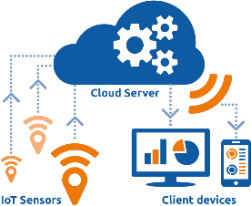


Solution & Technologies
Deep Learning
Statistical Analysis
Mobile Computing
and eLearning
Natural Language
Processing
Image Processing

Slide 6










Implemented Solutions
.
Prediction Modelling
CV Classification
E-KYC
Email and Document Classifier
Vehicle Recognition
Social feed Classifier
Chat Bot
Multi-Lingual Chat
Face Recognition
Drones

Slide 7


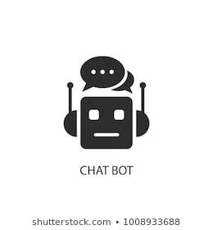



Solution Framework
Vehicle Recognition
Deployment
And Interfaces
Data Sources
Face Recognition
Data
On Premises
Cloud
Web API
Structured Data
Unstructured Rich data
Unstructured Data
Chatbots
Audio
classifier
Drone, store
Video analytics
Text Classifier
&
Summarization

Slide 8













Technology Stack
MOBILE TECHNOLOGY
NEAR REAL TIME ANALYTICS
MACHINE LEARNING
Generic/ Cloud

Slide 9
AI Enabled Stethoscope

Slide 10

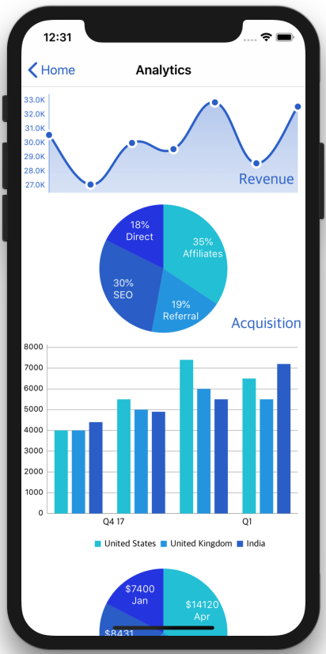


AI ENABLED STETHOSCOPE
AI & cloud driven heart lung symptom based abnormalities detection
Listen, Visualize and record
Tele medicine
Digital Stethoscope

Slide 11
HR Solutions

Slide 12

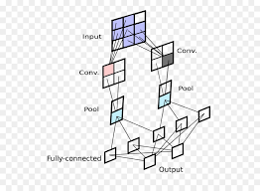


VIDEO ATTENDANCE
Authorized Person
Attendance Recorded
Convolution Neural Network
Unauthorized Person
Alert sent

Slide 13







OPTION 1: CAMERA BASED
Employee Enterns the hospital and stand near a designated camera
Yellow: Analyzing face
Green: Face Recognized
Data sent to Skybits System

Slide 14



OPTION 2: PERSONAL MOBILE APP
Hospital Wifi Network
Face Recognition with all data
Face-O-Detect mobile App
Video or Selfie taken
Data sent to cloud
API integration with Hospital software

Slide 15

OPTION 3: TABLET BASED
Face Recognition with all data
Face-O-Detect on Tab
Employee Stands infron the tablet
Data sent to cloud
API integration with Hospital software

Slide 16




HR CHATBOT
Checking Balance Leaves
Requesting for leaves
Company policies
Company newsflash
SKY CHAT
Complaint portal
Other HR activities

Slide 17
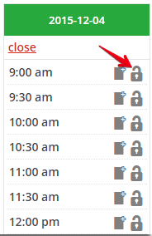
WEBSITE CHATBOT
Checking Availability of doctors
Scheduling Appointments
Hospital Policies
Hospital newsflash
SKY CHAT
Free online assessments
Online Pharmacy

Slide 18




RESUME CLASSIFIER
ML Algorithms reads JD &
scans list of CVs & web crawls through partner sites for matching CVs
Shortlisted CVs are ranked
Using Linear regression &
Latent semantic analysis
Only the top ranked
shortlisted individuals
are interviewed
HR receives Job
description from
respective department

Slide 19



APPRAISAL REVIEW SYSTEM
Number based Performance dEvaluation
Performance Benchmarking
KEY PERFORMANCE INDEX
Fact based
Uniform Measuring System
PERFORMANCE INDEX
Unbiased
Instant
Employee

Slide 20



ADMIN – DOCUMENT & EMAIL MANAGEMENT
Email Classification & routing to appropriate group based on content
Automatic document Cataloging, legacy data digitization and categorization for easier search.
Document Matching Solutions, by extracting information from documents. Coupled with Facial recognition, can be used in E-KYC verification

Slide 21

















Using Machine Learning in Digitization of Forms
1
Scan new documents
Documents from Current system
Upload Image
2
Key-Value
Extraction
Supporting
Documents
Image
enhancement
Extraction of
printed data
Extractions of
key – value pairs
Extracted
Data
Extract to tables
Audits
3
Location
Compliance
Data Validations
Other
validations
Photo
Verify
Validation OK
At Field or Branch
Extract to tables

Slide 22


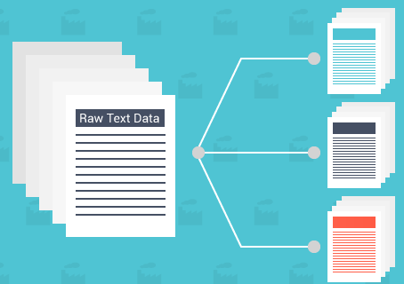
SOCIAL FEED CLASSIFIER
& RECOMMENDATIONS
Product Review Summarization based on feedbacks from social media / forums
Product recommendations based on past usage, patterns and statistical analysis
Automatic Customer Feedback Handling from company sites / social media; Routing

Slide 23




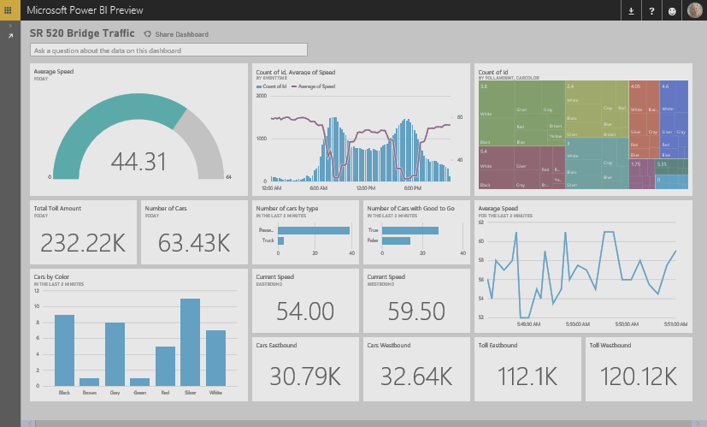

Automatic Handling of Customer Feedbacks
System Waits for new email and sends to the Classifier
Machine Learning
Based Classifier
Categorise reviews
based on feedback
Customer sends email to Customer Care
Take Appropriate Action
Based on Business Logic
Live Dashboard using streaming data

Slide 24






OUR CLIENTS

Slide 25
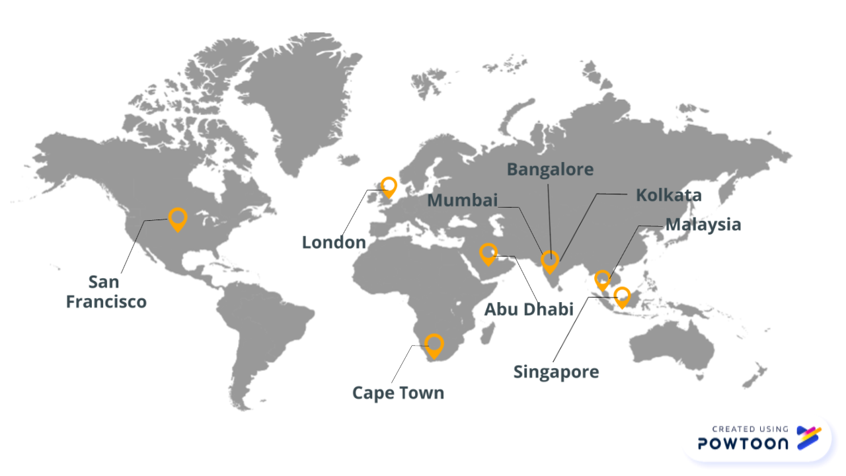
OUR GLOBAL PRESENCE

Slide 26
CONTACT US
+91-33-4000-3881
info@sky-bits.com
1416 DLF Galleria, Action Area 1B, New Town, Kolkata 700156, India
Visit us : http://sky-bits.com/

